Slide 1

MISPLACED CONNECTORS
SIX SIGMA PROJECT
Bertie Harte
T00209740

Slide 2
DEFINE: Problem Statement and Why Selected
Problem/Opportunity Statement | Desired-State
The sudden increase of genuine defects for misplaced connectors in the manufacturing process is resulting in greater than 300DPM (defects per Million). In the previous 20 weeks the defect rate was as at less than 50DPM.
PRIMARY: Return genuine defect rate to less than 50DPM for misplaced connectors.
SECONDARY: Complete without adversely impacting dropped component rates, overall costs and throughput.
Project Risk Analysis:
Specific : Raw Material Conformance & ASM Placement machine – connector handling.
Measurable: Raw Material qualification measurement report Is available. ASM vision system can provide measurement data for each component handled, option has been enabled.
Achievable : Support requested from Supplier Quality, Measurement Lab, Quality Engineering, Manufacturing Engineering and external specialists (ASM equipment experts)
Relevant : Risk of customer escape is high, management have directed that this problem be resolved.
Time Bound: Lead time for original connector is 6 to 8 weeks, efforts must address the stock in hand within this time frame.
Why This Project?
Immediate Risk to Customer
Currently impacting production availability.
Dropped Component KPI is out of limits because of efforts to resolve.
Notes:
2

Slide 3
DEFINE: Related Projects & Constraints/Assumptions
Related Projects:
A Related project to improve detection rates at AOI (Automated Optical Inspection) and ICT (In-Circuit test) for misplaced connectors is ongoing by Test Engineering (not part of this project).
The supplier change from GSN to LAIMU was driven by a cost-saving project from material purchasing group. Any decision to reverse this change will need to involve this group.
Constraints: The cost savings from GSN to LAIMU are significant, it is unlikely that reverting to GSN will be an acceptable outcome, especially as product is going end of life. Therefore it is important that we manage the identified risks effectively.
Assumptions: Customer Protection is the absolute priority.
Production demands are steady for the next 12 months but will cease after this time.
LAIMU parts meet our specifications and have been suitably qualified for production (Validated and Released).
Any remaining GSN stock can be consumed to validate/verify any findings or recommendations.

Slide 4
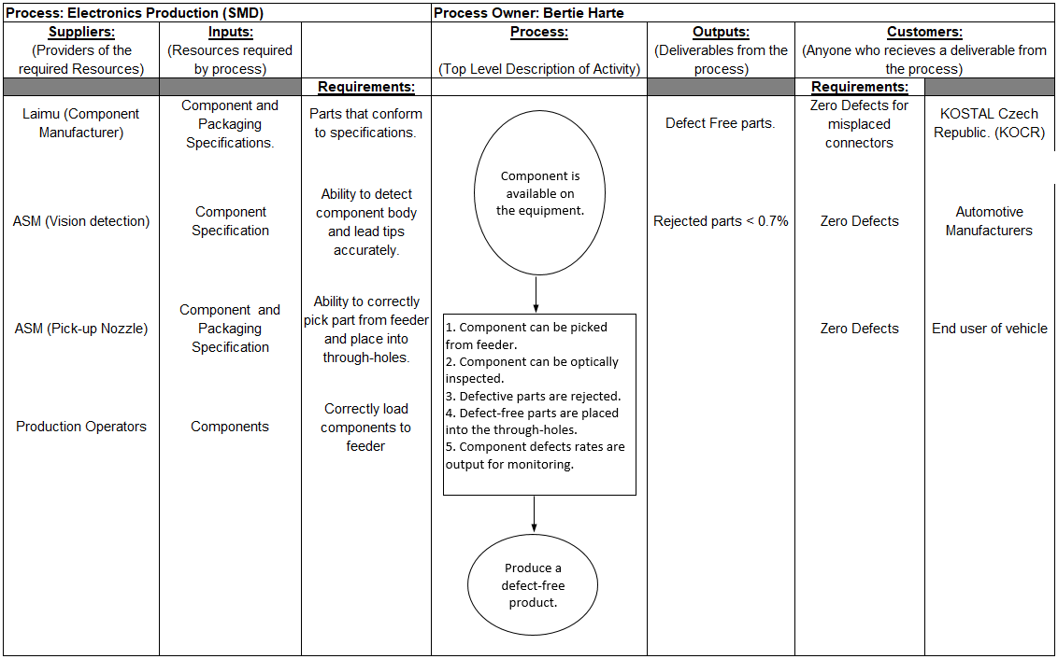
DEFINE: SIPOC
Notes:
4

Slide 5
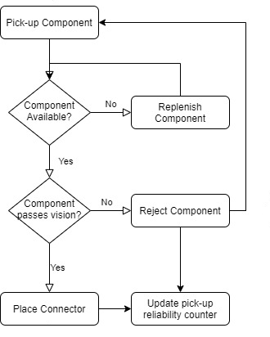
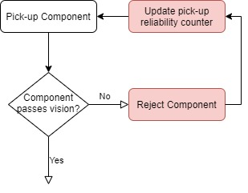
DEFINE: CAUSE AND EFFECT
To understand probable causes for the misplaced connector the pick and place process was mapped.
Full Pick & Place Sequence
Vision Fail loop (Feeder Fallout)
The failure mode for a misplaced connector is when the pins of the connector do not align with the through-holes.
However, as the connector is only placed after passing the vision inspection, the actual fault is the incorrect “pass” of a connector prior to placement.
Analysis of the shift log (report) and the technical report points to an intervention by the line technician which modified the vision algorithms.
This action was carried out as an attempt to reduce excessively high dropped components and machine stoppages. (Feeder Fallout is a KPI)
In turn this initial increase in dropped components was directly linked to the introduction of the LAIMU part.
The sequence is outlined below.

Slide 6
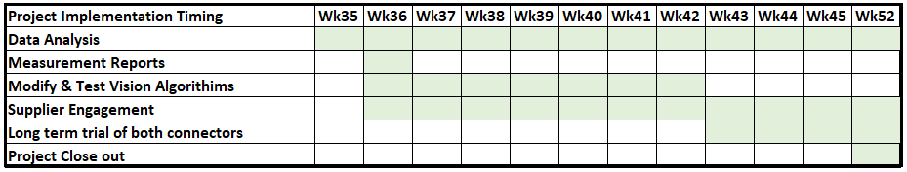
DEFINE: Project Plan
Phase Summary:
Problem identified with LAIMU connector resulting in a high drop rate (Feeder Fallout).
Efforts by the line technicians to remedy this resulted in the camera systems passing defective parts. This directly resulted in the spike of genuine defects.
Notes:
6

Slide 7
MEASURE: Measurable Analysis
Type of Measurement | What we need? | What can we deliver?
Genuine defect rate | Current and historical defect rates. | Current and historical defect data from production system.
Component dimensions. | Component dimensions from specification document that suppliers have provided. | Actual measurements of material for comparison.
Component dropped rate. | Current and historical data for comparison. | Current and historical data from ASM equipment.

Slide 8
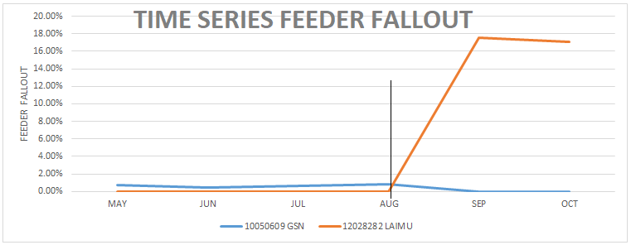
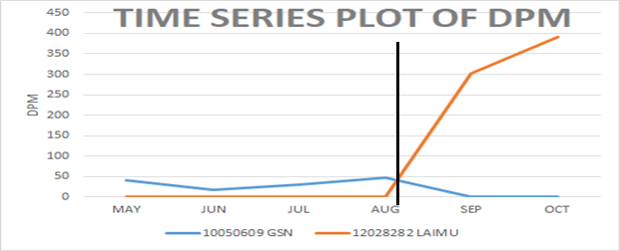
MEASURE: DPM & Feeder Fallout Analysis (Baseline Data)
Time Series of genuine defects and Feeder Fallout up to project start.
(Vertical line is point where Laimu connector was introduced in-place of GSN.)
Historical data demonstrates that the component supplied by GSN performed well.
The change to the LAIMU part, resulted in the sudden spike in Feeder Fallout.
The intervention by the technician to address this spike was the cause of the increase in defects.

Slide 9
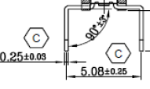
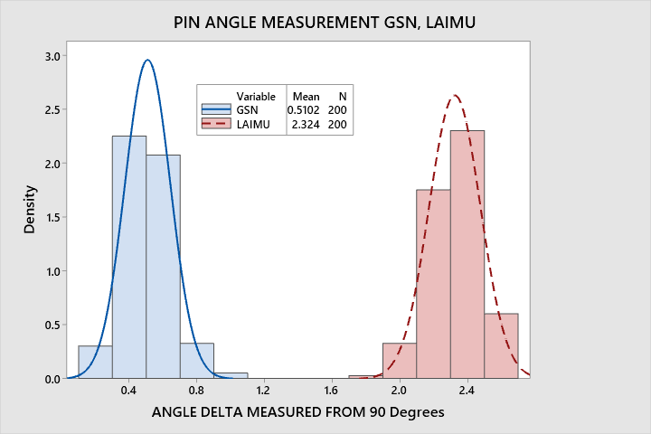
MEASURE: Raw Material Measurement
Measurement for both connectors using the specification datasheet were conducted.
Critical Measurements are the distance between pins (5.08 ±0.25mm) and pin angle (90 ⁰ ±3 ⁰)
Incorrect formation of the angle will results in the incorrect distance between pin tips, this will prevent the pins lining up with the through-holes.
The measurement is delta from 90 degrees.
STATISTICAL ANALYSIS.
The data shows that individual pins of LAIMU connectors, while within the specification of 90 ⁰ ±3 ⁰ are skewed toward the upper limit.
The measured values for LAIMU have a mean of 2.32
The Min/Max delta correspond to a lateral deflection range of 0.09mm to 0.14mm per pin (limit is 0.125).
Working on the mean value the deflection on a single pin would be 0.122 (limit is 0.125).
However where 2 opposing pins are deflected the combined deflection may exceed the agreed tolerance of (5.08 ±0.25mm)
This information was communicated to supplier quality to engage with the supplier to see if their process could provide pin angle closer to 90 ⁰
Recommendation to tighten the angle tolerance to ±2.3 ⁰ so that maximal deflection on 2x pins will not exceed the 5.08 ±0.25mm critical dimension
Histogram of angle measurements GSN & LAIMU Connectors.
Sample of 200 measurements (Delta from 90 ⁰)(pins 1 to 4) on 50 connectors.
Specification is 90⁰ ± 3 ⁰

Slide 10
ANALYSE: Identify the main cause.(Brainstorming)
Things we Know:
LAIMU connector led to an increase in Feeder fallout
Technician modified vision algorithm to address this.
Modified algorithm did not detect splayed pins.
This resulted in defects (Misplaced Connectors)
We can revert vison algorithms from backup.
Things we don’t know:
What the vision failures were for?
What exactly the modifications were.
Why splayed pins were passed in error.
There are 2 main causes to consider.
The actual cause of the failure is the vision system not detecting bad components – this must be addressed.
The initial problem with the LAIMU connector causing the increase in feeder fallout – this must be understood.

Slide 11
ANALYSE: REVISIT CAUSE AND EFFECT
Reusing the process maps we can focus on the specific area of vision, particularly the vison fail loop.
Full Pick & Place Sequence
Vision Fail loop (Feeder Fallout)
To begin we need to determine exactly what the vision algorithm is measuring and how it is subsequently processing the measurements.
To do this the historical algorithms were restored from backup dated 02nd AUG, before the problems occurred.
Before the restoration a copy of the current (bad) settings was captured for comparison.
The programmed data matches the specification.
A series of validation test were conducted using 50 known “good” GSN parts – to verify the process.
A series of trials were conducted on the suspected “bad” LAIMU parts – to see how these were failing.
The initial sample size was to be 50 of each, however the LAIMU parts failed so often that the trial was abandoned after 20, as a clear picture of the failures emerged.
Component | Tested | Rejected | %
GSN | 50 | 1 | 2.00%
LAIMU | 20 | 8 | 40.00%

Slide 12
ANALYSE: FINDING THE FAILURE
The vision system is programmed with a digital model, mirroring the specification of the components.
Each of the 4 individual pins is searched for.
Once detected each pin is evaluated for position and size relative to programmed positions and tolerances.
Once all 4 pins are determined the offset (pitch) between pins is evaluated relative to programmed values and tolerances.
Only when all 4 pins are within the programmed values is the part passed.
FINDINGS GSN:
The vision system correctly located and identified each of the pins.
All pins were found to be within the positional tolerances relative to each other, and relative to the component centre.
The vision algorithms returned an acceptance value (pass rate on inspection) of >90% (lower limit is 80%)
Additional test modes (robustness checks) all passed, demonstrating that the GSN parts completely satisfied all programmed requirements.
Visually the camera image was sharp and the pins were well defined (high contrast, no deflection of illumination)
FINDINGS LAIMU:
The vision system could not locate and identify all of the pins on some of the samples that failed. At least one pin not found.
Where all pins were found they were outside the positional tolerances relative to each other, and relative to the component centre on some of the fails.
The vision algorithms returned an acceptance value (pass rate on inspection) of <60% (lower limit is 80%)
Additional test modes (robustness checks) all failed, demonstrating that the LAIMU parts did not satisfy all programmed requirements.
Visually the camera image was sharp but the pins were not well defined (low contrast, and visible deflection of illumination, leading to false readings)

Slide 13
ANALYSE: DOCUMENTING THE FAILURE
The trials of the connectors demonstrate that the LAIMU part is problematic at vision and echo the initial events where the technician intervened.
From the earlier measurement report we can see that the LAIMU part is at the upper end of the tolerance range, and the maximum values exceed the 5.08mm ±0.25mm critical dimension.
We can then calculate a revised limit for angular deflection that results in values below the critical 5.08mm ±0.25mm limit. This would be ±2.37 ⁰
Revisiting the measurement report we can then make a reasonable assumption (albeit based on a small sample size) that 37% of the LAIMU parts would fall outside of this limit, this would be impossible for production, and would result in machine stops and the KPI of feeder fallout would be out of limits.
Again, this correlates with what occurred where the technician initially intervened.
If this were to continue in actual production, without the machine accurately detecting the failure the result would be the genuine defects were are seeing.
We must therefore balance the primary goal of defect prevention with appropriate detections that still allow production to run, otherwise the cost implication for achieving the desired quality outcome becomes excessive. (Machine stoppages and component waste).
This reinforces that the actual cause of the defects was the modification of the vision data, as this allowed bad parts to pass.
The driver for this action is directly related to the quality of the LAIMU material, and how the vision system can’t currently process it – this is where the improvement will be made.
SUMMARY: IMPROVEMENT PHASE.
We must ensure that the vision algorithms correctly identify the pins, therefore modification will be required to improve LAIMU detection.
All pins must be found to be within the positional tolerances relative to each other, and relative to the component centre. The tolerances must not allow for bad parts to be passed.
Where possible, without affecting the primary goal of defect reduction, some modification of the vision algorithms to reduce feeder fallout may be possible.
Where this is not possible the prudent course of action would be to revert to the better GSN component pending supplier engagement.

Slide 14
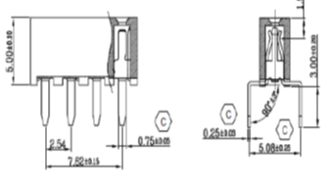
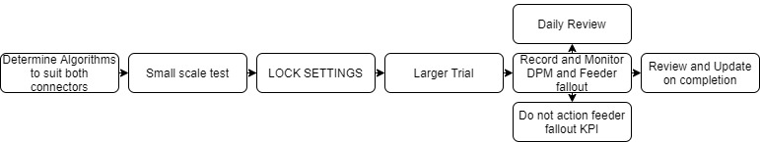
Improve: Reducing the Failure
The inability to detect all pins is directly linked to the camera not being able to pick out the pin tips due to deflection of the lighting.
Adjusting the lighting to eliminate background lighting noise resulted in a higher contrast on the pin tips.
This allowed the vision system to locate and measure all 4 pins.
However, the pin tips appeared smaller than the programmed limits and failed the inspection for “size”. They also didn’t appear as regular rectangle due to the shape of the pin tip.
While an improvement from the initial state, additional modifications were required.
Using the specification drawings pin tips were reprogrammed as circular objects ,diameter 0.5 ±0.3 mm
Despite the pins being rectangular the “circle” object proved to be better at detection.
This resulted in 100% pin detection, the actual fails were now for pitch position errors.
Each failure occurred because the position between pins exceeded the 5.08mm ±0.25mm limit. (Classed as a genuine reason to reject)
At this point the programmed vision algorithms were deemed to be correct for the both the GSN and LAIMU connectors.
In order to validate these new parameters a larger trial was agreed.
The modified vision algorithms were access restricted to prevent any modification.
For the duration of the trial production staff were asked to take no action on the KPI of Feeder fallout for the GSN and LAIMU connectors.
The trial follows the action/event plan below.
Component | Tested | Rejected | %
GSN | 10 | 0 | 0.00%
LAIMU | 10 | 3 | 30.00%
Component | Tested | Rejected | %
GSN | 100 | 1 | 1.00%
LAIMU | 100 | 5 | 5.00%

Slide 15
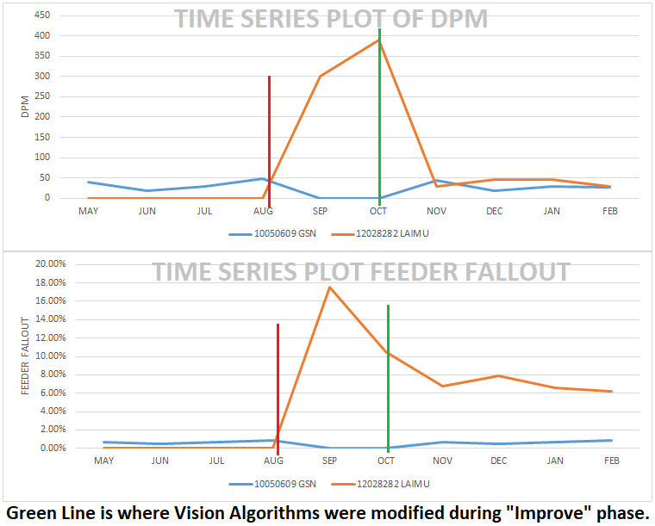


Improve: Results of the Trial
The trial was conducted over a 12 week period. A similar number of components from GSN and LAIMU were consumed.
During the trial period no modification to the vision algorithms were made.
The aim is to assess if the DPM value returns to the target of <50, and to measure the feeder fallout.

Slide 16
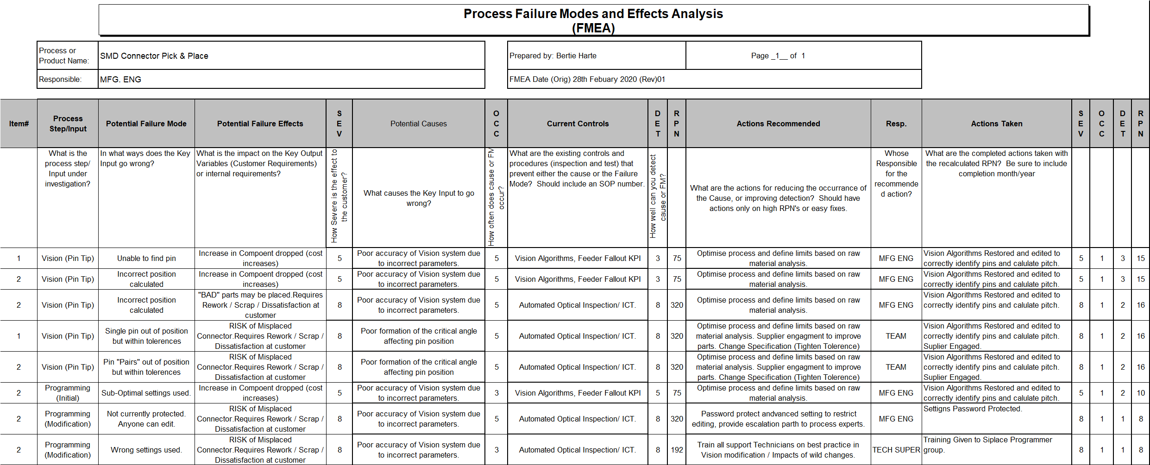
Improve: FMEA – Risk Assessment
Using the information gathered during the define, measure and improve phases the FMEA exercise was completed to document the problem.*
*note: As no prior FMEA existed the initial state was populated with the discovered faults and the measured impact prior to project commencement. The changes made during the improve phase are recorded and assessed under the actions sections.

Slide 17
Improve: Phase Summary
Measurement report highlighted a potential problem with LAIMU parts.
Mapping the failure loop gave specific focus to the problem area.
Reverting the vision parameters to a previous state was an important step in understanding the initial failure.
Careful, and measured analysis, and planned trials based on those findings was essential in improvement. (Scientific / Logic based approach)
Recognition that not having a password protection in place was an oversight.
Long term trial demonstrated that the implemented improvements meant the priority of <50DPM was realisable.
Reduction on LAIMU Feeder Fallout was also possible (Reduced from 18% to 7%)
Analysis of the “Bad” vision algorithms found that main differences were in lighting and pin pitch values.
Further modification or widening of pitch tolerances would increase risk of having >50DPM, no further action on current LAIMU parts proposed (“live with” Fallout).
Supplier engagement to improve the accuracy of 90⁰ pins has begun.
Efforts underway to tighten the tolerance on the pin angles, to remove tolerance overlaps.

Slide 18
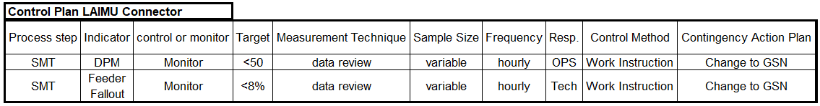
Control: Monitoring
Existing KPI are acceptable for DPM monitoring.
Exception in KPI for the increased feeder fallout for LAIMU parts.
This exception has been communicated via internal channels.
Component dropped log modified to no longer alarm for this value.
Connector Misplacement has been added to weekly improvement meetings for mention/monitoring
FMEA to be referenced for all changes to connectors going forward.
Control Plan updated for this specific problem.

Slide 19
Project: Summary &Lessons Learnt
  A major failure occurred when the LAIMU parts were introduced without doing a full production validation, a small production run was completed prior to volume introduction.
  Validation report mentioned the issue with pin angle distribution, however failed to connect this to the potential for failure on the critical pitch dimension.
  A review of all connectors is required to check for tolerance overlap.
  Password protection of critical machine parameters is now standard.
  Data analysis, process mapping, brainstorming and FMEA all critical in resolving the problem.

